Slide 1
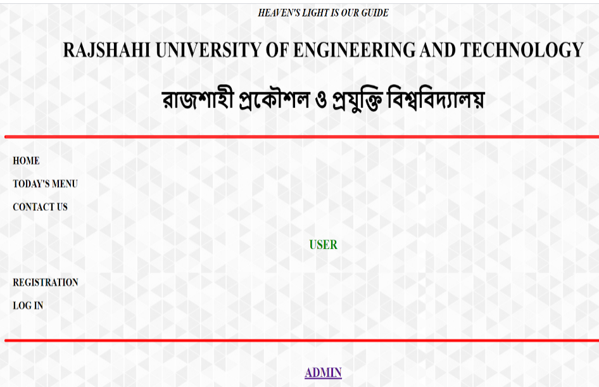
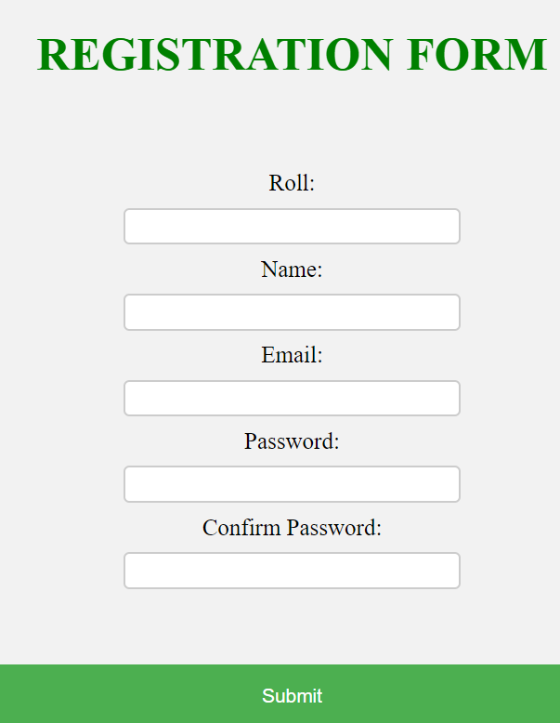
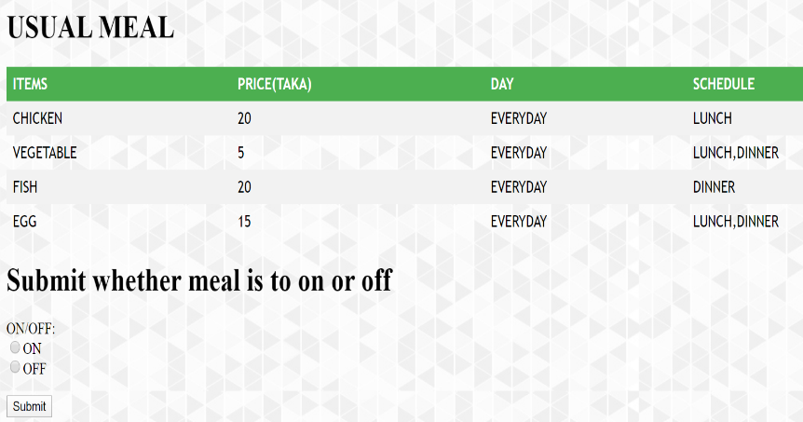
HALL MEAL SYSTEM, RUET
Features and Interface of the website
Students can sign up with their student ID and can log in with their ID and Password After log in they can on or off their meal system.
They also can see their every day charge for meal.
Admin can see the students log in information and can also see the details of students whether their meal is on or off.
GM MEHRAB HOSSEN
1603027
What is online hall meal system?
An online website where every day meal, bill and payment of every student of RUET can be found.
Equipments needed for the project
Operating System (Windows 10)
Microsoft Visual Studio Code
XAMPP as Hosting server
MySQL for using Database
Google Chrome Browser
PHP, HTML, CSS etc. as the programming languages for Coding and designing stuff.

